Slide 2
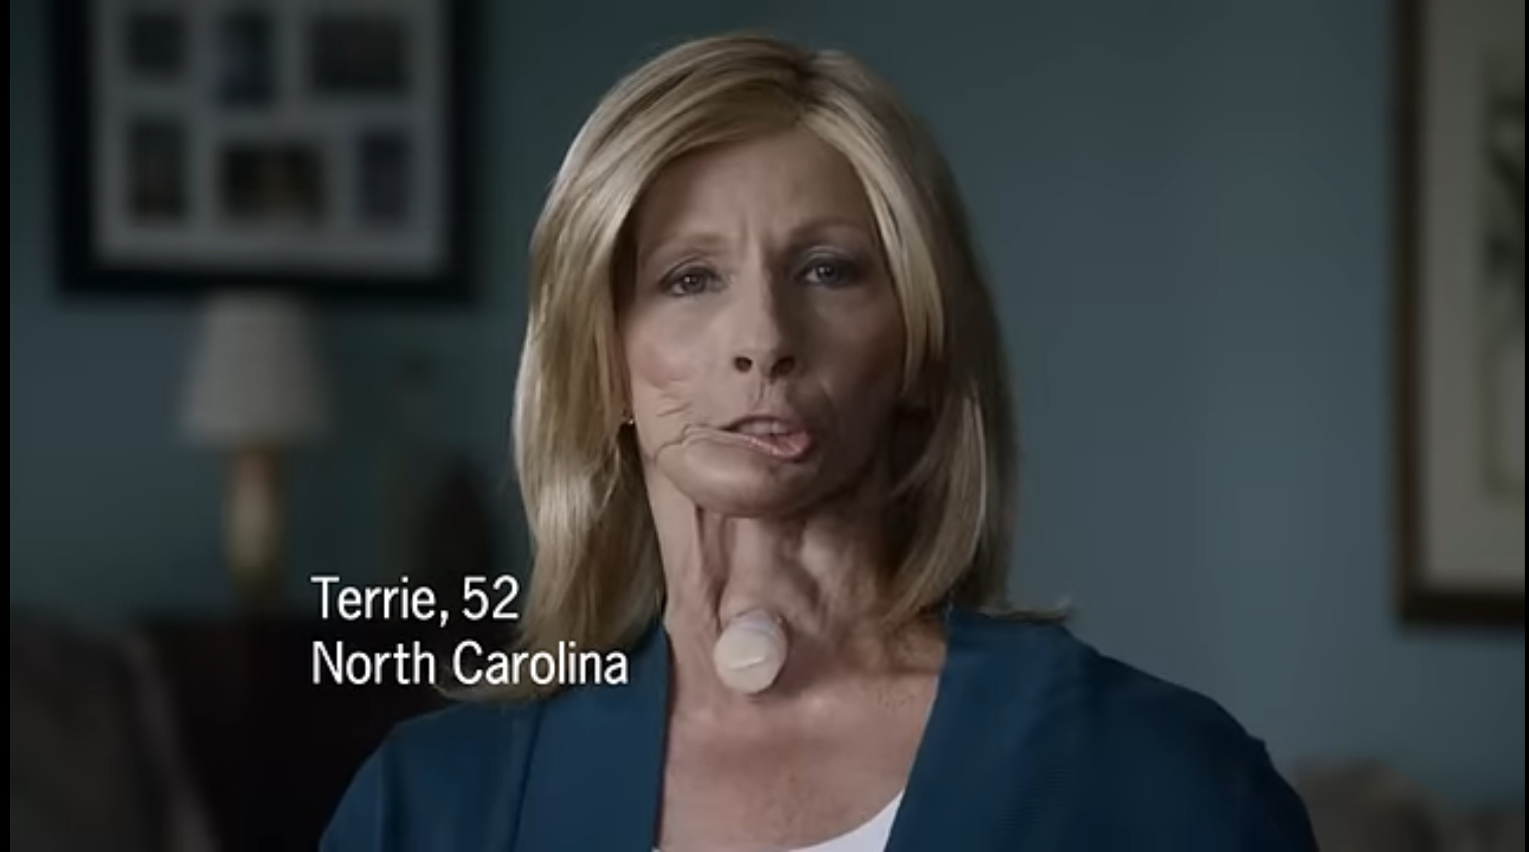

Slide 3

What Sin Does
The story of 2 Samuel 11

Slide 4
Sin always deceives
Our sense of Self
Our View of others
Our View of God

Slide 5
Sin always destroys
Relationships
Conscience
Empathy

Slide 6
Sin is always discovered
By the LORD
By others
In judgment

Slide 7
The Treatment
Truth
Confession to God
Confession to others
The Truth of the Cross

